Slide 1
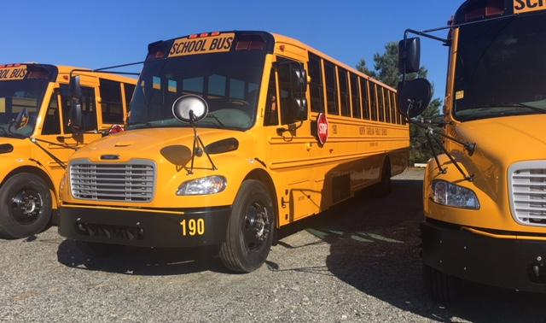
Rockingham County School Bus Drivers
Orientation 2022/2023

Slide 2
Welcome Back!
Make sure that you complete all the required paperwork to receive credit for attending today. (Driver Information Sheet & Transportation Services Agreement)

Slide 3
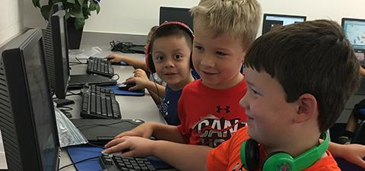
School Bus Drivers transport the world’s most precious cargo!

Slide 4
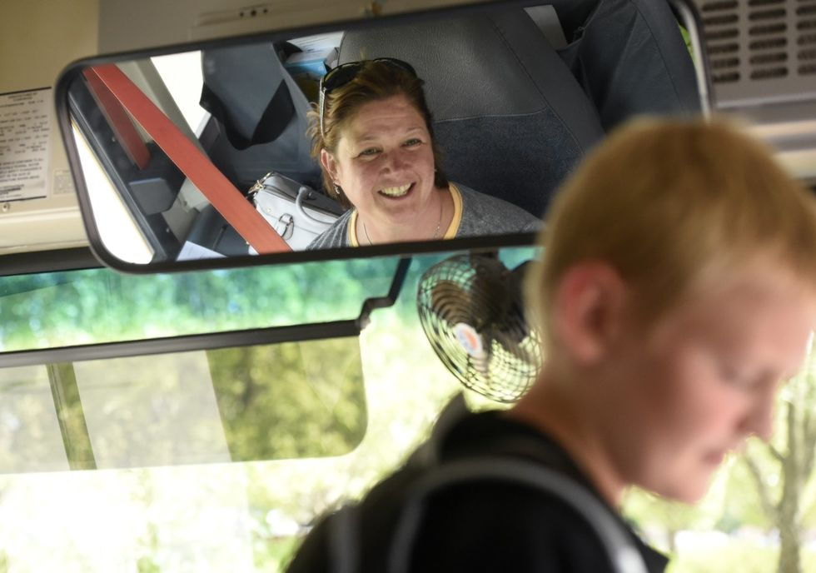
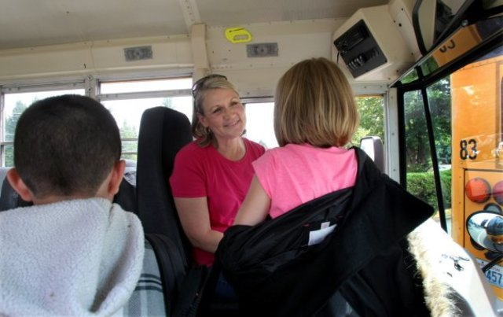
Greet your students in a positive manner…..Like this!

Slide 5
Do you know……
Do you know what the most important safety feature is on a school bus?
VIDEO
VIDEO

Slide 6
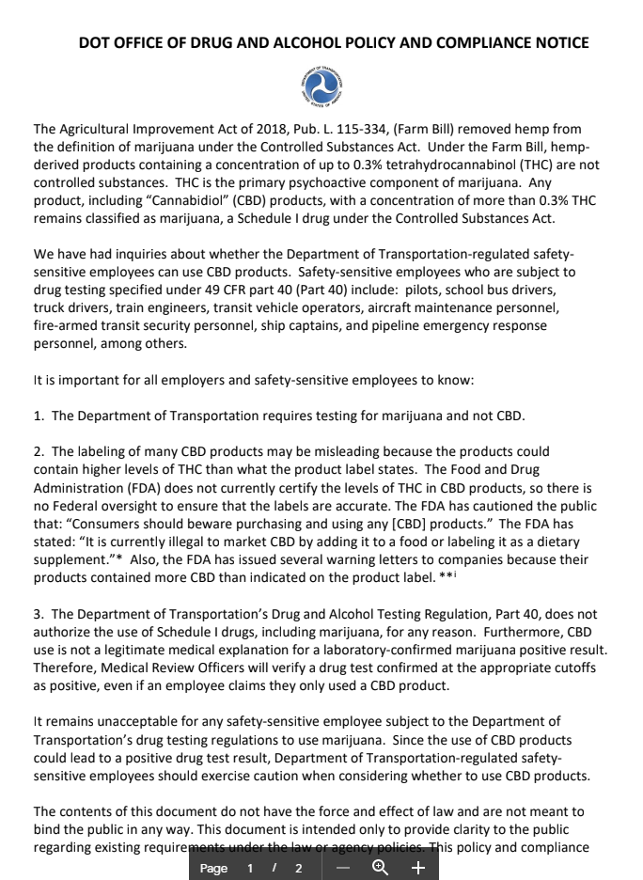
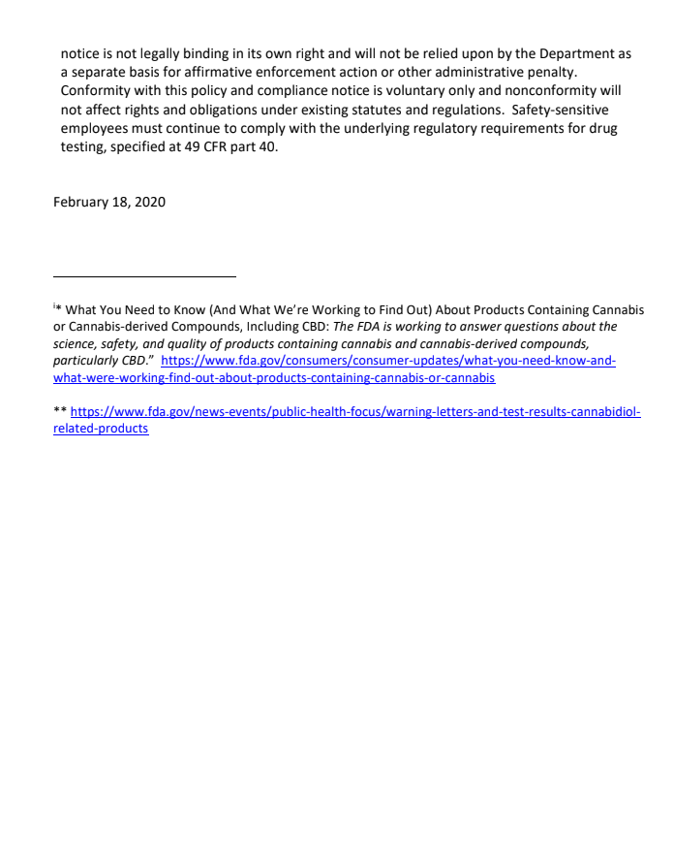

Slide 8
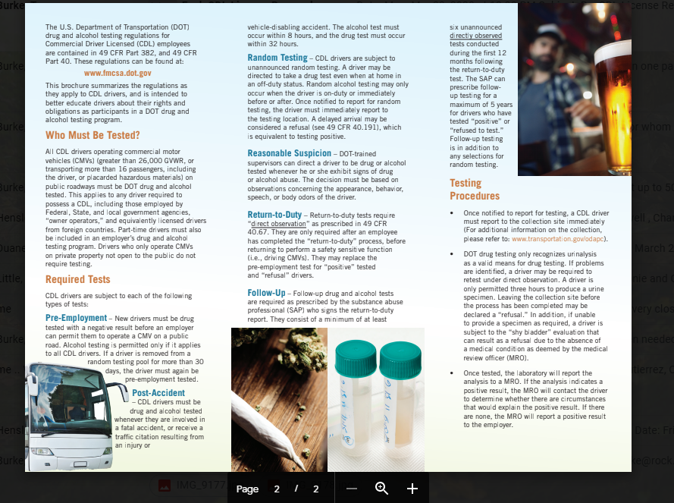

Slide 9
Driver Recertification/DOT Physical
RENEWAL
The NC/DEPS instructor will schedule a time for you to drive in order to be recertified as a school bus driver. After obtaining your state license, you will need to send a copy of your permanent license to the RCS Transportation Department. Drivers will be paid for one hour to compensate for renewal. The Finance Department will be notified by the Transportation Department to pay you for this time.
NCDOT Physical
All school bus drivers must obtain a NCDOT Physical. The driver and their supervisor will receive an email to remind them of the upcoming requirements. A designated person from the RCS Transportation Department will notify drivers and supervisors of onsite DOT Physical appointments. Onsite DOT physicals take place at the RCS Transportation Department. Drivers will be registered for the appointment by phone. Reminder emails will be sent 45, 30, and 15 days prior to the appointment.
BEHIND THE WHEEL RECERTIFICATION PAY
Drivers will be paid for time spent for recertification and behind the wheel training. You will not need to clock in for this time. The finance department is notified by the transportation department of time spent for renewals and behind the wheel training time.

Slide 10
CELL PHONE USE
HOUSE BILL 183
The General Assembly of North Carolina enacts: At no time can a bus driver use a cell phone while driving a bus.
A violation of this section shall be a Class 2 misdemeanor and shall be punishable by a fine of not less than one hundred dollars. The violation will also result in the loss of the driver’s pocket card for a period of one year and the driver will be required to attend additional School Bus Driver training.
NO TEXTING WHILE DRIVING!!!!

Slide 11
Two-Way Radios
Two-Way Radios have been installed on ALL Buses
Radios are wired to turn on when the bus is cranked.
Keep Radio on Channel 1 (Dispatch) and make sure the volume is at a level that you can hear.
Please notify the garage or your mechanic if you have any issues with the radio on your bus!

Slide 12
4 Golden Rules for Radio Communication
Clarity - Your voice should be clear. Speak a little slower than normal. Speak in a normal tone, do not shout.
Simplicity - Keep your message simple enough for intended listeners to understand.
Brevity - Be precise and to the point.
Security - Do not transmit confidential information on a radio. Remember, frequencies are shared, you do not have exclusive use of the frequency.

Slide 13
Basic Two-Way Radio Etiquette
When using a two-way radio you cannot speak and listen at the same time, as you can with a phone.
Do not interrupt if you hear other people talking. Wait until their conversation is finished unless it is an emergency. If it is an emergency, inform the other parties that you have an urgent emergency message.
Do not respond if you aren’t sure the call is for you. Wait until you hear your call sign to respond.
Never transmit sensitive or confidential information. Assume your conversations can be heard by others.

Slide 14
Basic Two-Way Radio Etiquette (Cont.)
Perform radio checks to ensure your radio is in good working condition.
Ensure the power is on.
Keep the volume high enough to be able to hear calls.
Make regular radio checks to make sure everything is working.
Think before you speak.
Decide what you are going to say and to whom it is meant for.
Make your conversations as concise, precise, and clear as possible.
Avoid long and complicated sentences.

Slide 15
Making a Call - Follow these easy steps
Listen to ensure the channel is clear for you.
Press the PTT (Push-To-Talk) button.
After 2 seconds:
Say “BUS GARAGE, THIS IS <BUS NUMBER>”
Once the person replies, convey your message.

Slide 16
Radio Communication Tips
Leave a second or two between “hand-offs” to give others a chance to break in.
It is always best to speak in short simple phrases on the Radio
Don’t speak immediately when you press the PTT (push to talk), digital radios have a slightly longer delay. Wait a couple of seconds.
If you speak as soon as you press the PTT button, it can chop off the first syllable or word, making it hard to understand. If that word doesn’t make it, you will just have to say it again.

Slide 17
Bus Folders
Each bus will have a folder that must remain on the bus at all times. The folder will include the following:
School Bus Seating Chart
TD-29
Emergency roster/sign out sheet.
*Make sure the folder is up to date and available for sub drivers.

Slide 18
Sign-in Sheets
Sign-in sheets are to be completed for both morning & afternoon routes. Schools have been instructed to use separate sheets for each route.
Bus Driver Sign-in Sheets are a requirement of the North Carolina Department of Public Instruction. These sheets are used to verify that pre and post-trip inspections are being performed and to verify that requested repairs have been reported.
Only you (the driver) can sign in on the sheet! No one else can sign in for you.
*If you find an issue during your post-trip inspection in the afternoon, call the bus garage so that the route will not be delayed the next morning.

Slide 19
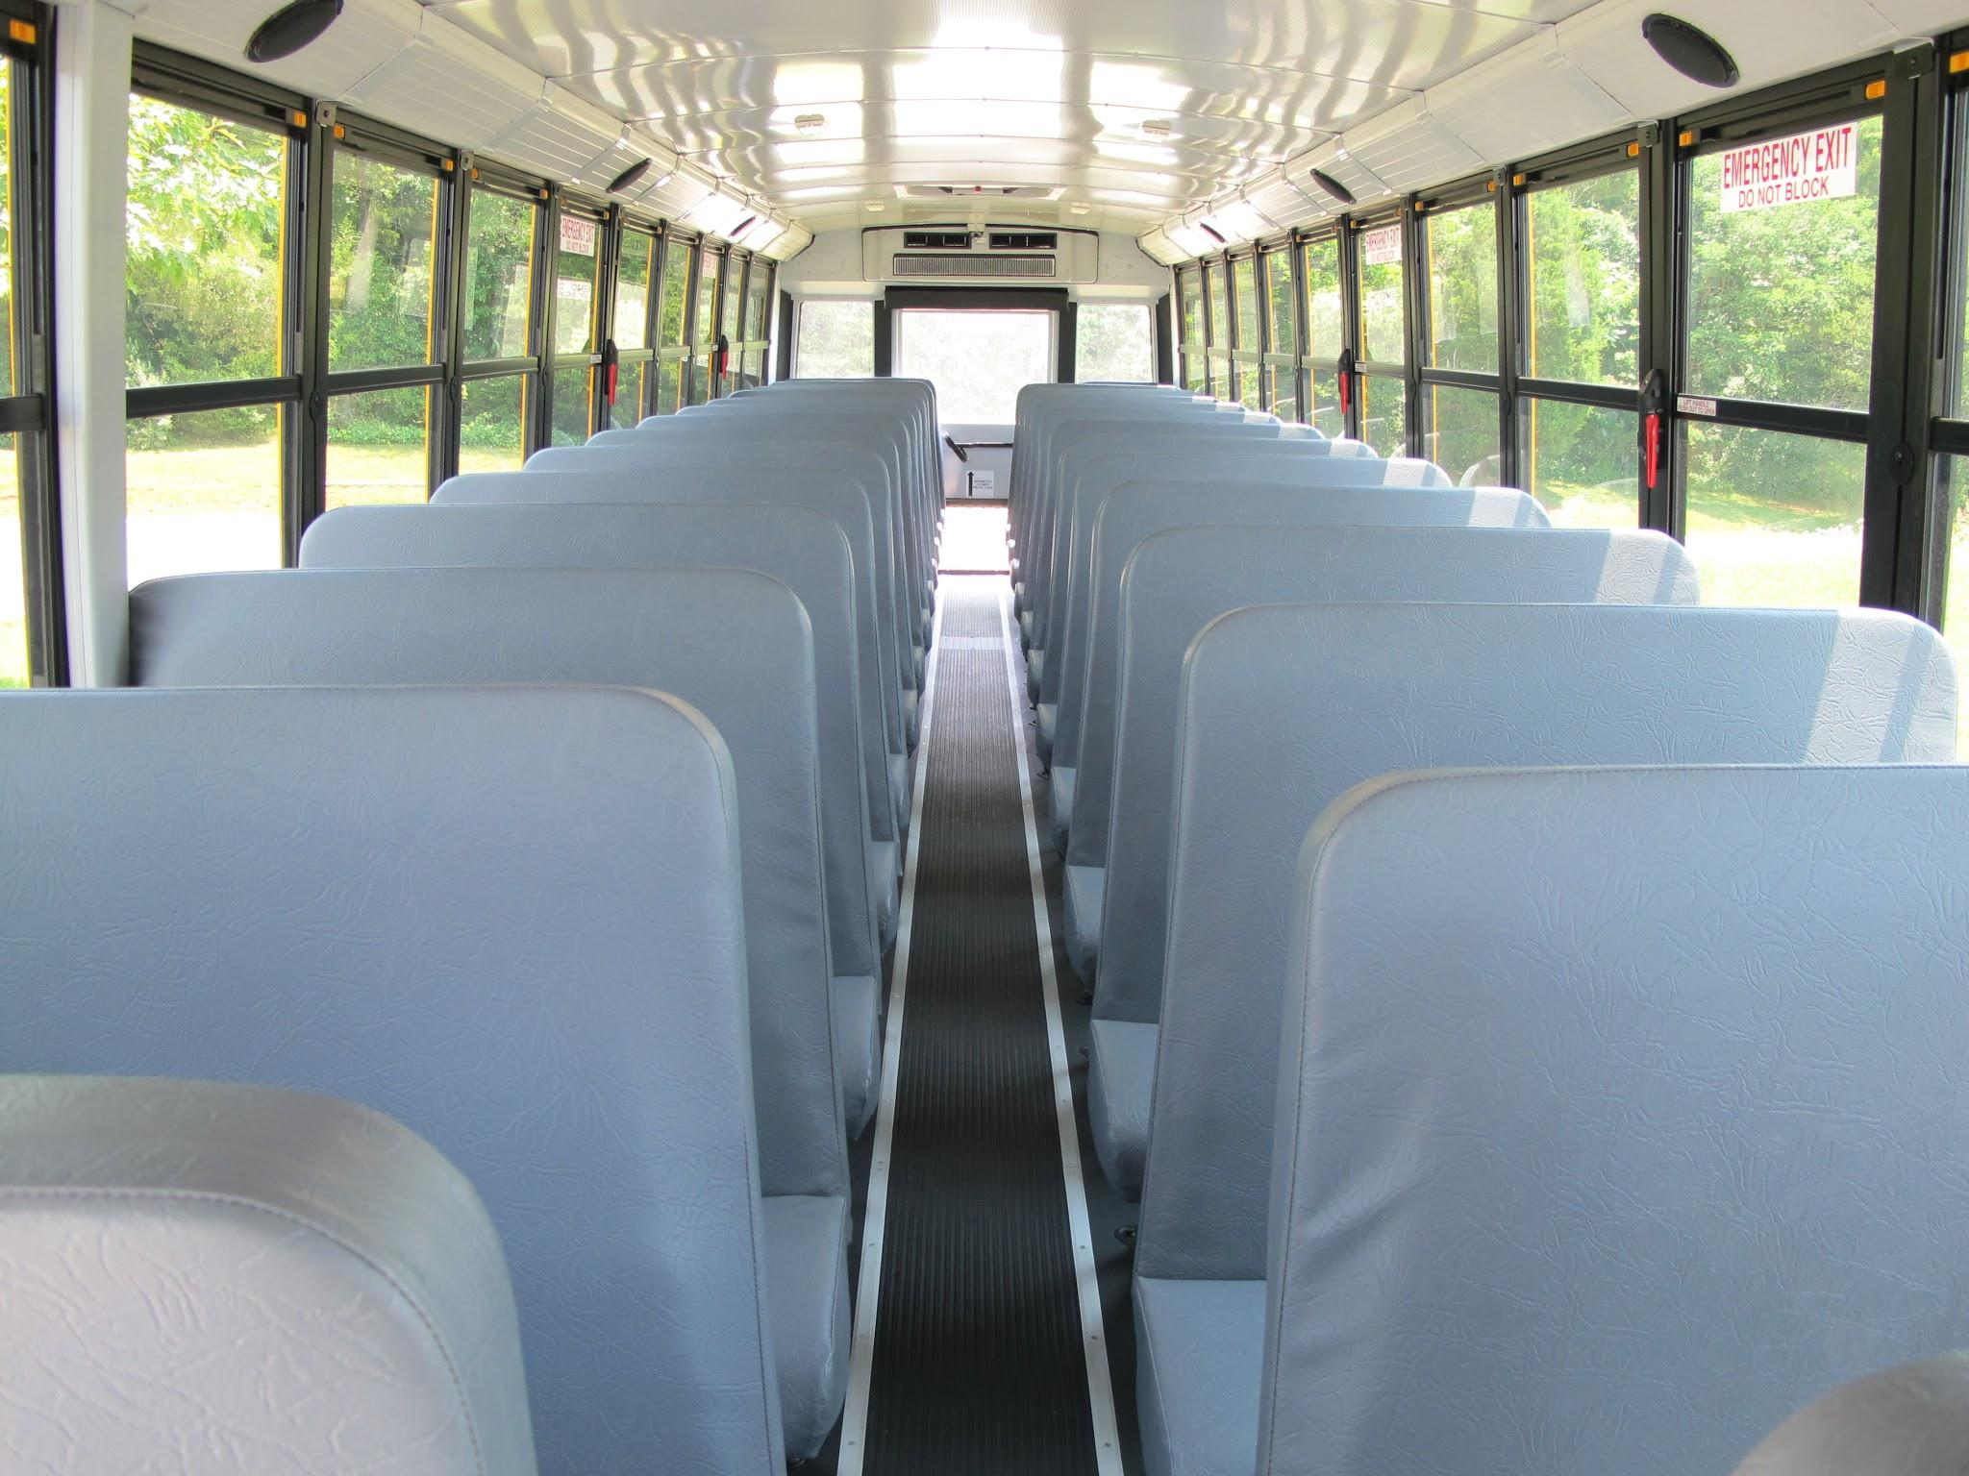
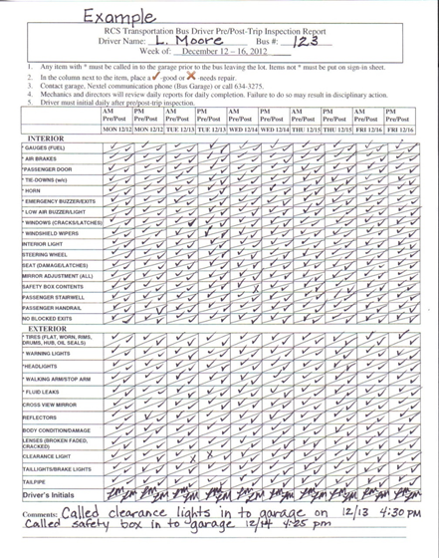
Inspection Booklet Vandalism
Every bus will have an inspection booklet
Be sure to inspect passenger seats and report all damage.

Slide 20
HEADCOUNT SEPTEMBER
Accurate
Signed and Dated
AM & PM
Legible
Turned in on time
Incentive pay
IMPORTANT

Slide 21
STOP ARM VIOLATIONS & ROAD REPAIR REQUEST
STOP ARM VIOLATION
Needed Information
Date, time, and road where violation occurred
Direction the bus was traveling and whether students were loading/unloading
Vehicle description: make, color, and license plate number
Driver description: race, sex, age, hair color
Phone number to reach the bus driver
ROAD REPAIR REQUESTS
Please print clearly and legibly
State your request precisely
Sketch your location to the best of your ability
Fax your request to the Transportation Department
Forms can be accessed on our website
http://www.rock.k12.nc.us/transportation

Slide 22
EMERGENCY EQUIPMENT
During the pre-trip inspection it is imperative that you check the fire extinguisher to make sure that it is charged and secured. The needle on the gauge should be in the green area.
Check the first aid and body fluid kits. Notate on the sign in/sign out sheet if any items need to be replenished.
If the bus that you are driving is equipped with reflective triangles, there should be three in the box.

Slide 23
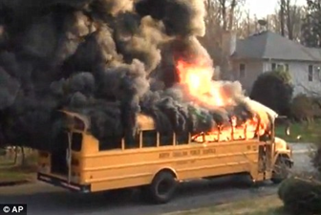
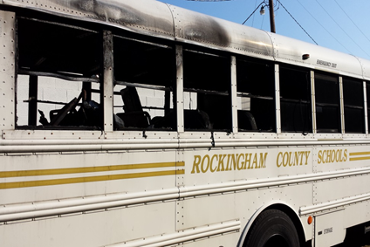
EMERGENCY EVACUATION
The driver will have a plan in place in the event of an emergency and go over it with students within 5 days of school starting.
Identify the EMERGENCY EXITS for the students.
Explain which EXIT to use in the event of an emergency.
An Emergency Evacuation Plan should be reviewed with the students at the beginning and during the middle of the school year.
Please note on the sign in sheet that the Emergency Evacuation Plan has been reviewed with the students on that particular day.
Tornado Evacuation Evacuation

Slide 24
EMERGENCY EVACUATION PLAN IN THE EVENT OF A BREAKDOWN
Suggested Procedures
Park the bus as close to the shoulder of the road as possible.
Turn the hazard lights on.
Set the parking brake.
Turn the engine off.
Evacuate the students in an orderly fashion.
Remember that a bus can be replaced but a student cannot!

Slide 25
EMERGENCY PROCEDURES IN THE EVENT OF A HIGHWAY ACCIDENT
School Bus Drivers are to:
Check the passengers for injuries.
Check occupants of the other vehicles.
Call 911 and they will notify the Transportation Department.

Slide 26
NO IDLING POLICY
If the bus engine is running you should be in the driver’s seat. The no exception! Even if you are performing a pre/post-trip inspection. You are not to start the bus, turn on the lights, and then walk away from the bus leaving it unattended.
RCS No Idling Policy can be found on the Rockingham County Schools website at http://www.rock.k12.nc.us/transportation

Slide 27
DRIVER COMPARTMENT/BACK OF THE BUS
Driver Compartment
Keep the driver compartment clean and free of clutter. Anything labeled “Harmful to Children” may not be kept on the bus.
North Carolina will not permit de-icer or tire clubs to be kept on the school bus. No signs or posters are allowed to be hung inside of the bus.
Back of the Bus
Keep the rear exterior of the bus clean enough that the lights and the words “SCHOOL BUS” can easily be seen.
It is the driver’s responsibility to check the back of the bus during pre and post-trip inspections.
Any sign placed on the bus by the manufacturer or DPI must be visible.

Slide 28
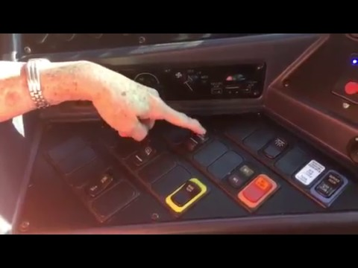
Blue Bird Buses and Master Switch
The Master Switch must be turned on.
The Warning Lights will not activate
without turning on the Master Switch.

Slide 29
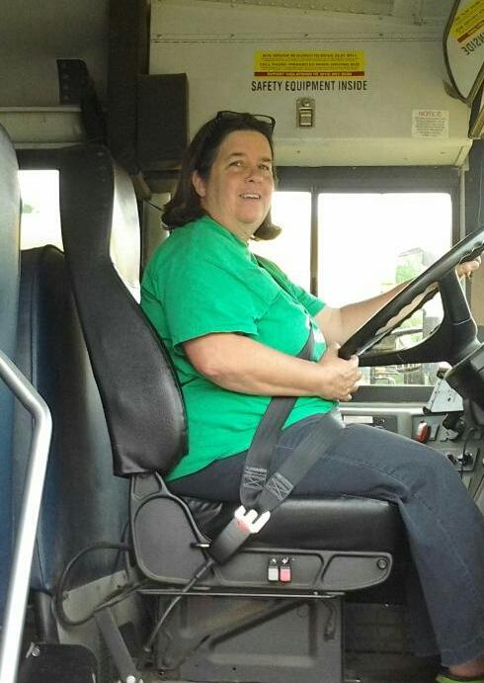
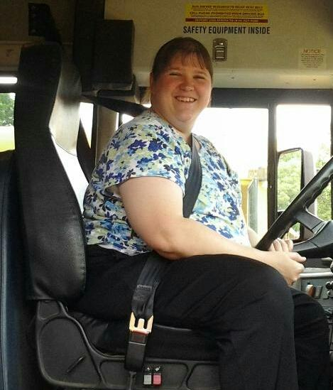
WEAR YOUR SEATBELT

Slide 30
MECHANICAL PROBLEMS
Mechanical problems should be noted on the sign-in sheet.
The Transportation Mechanics appreciate a specific description in order to locate and make needed repairs. Example: stop arm not working, strange noise and where is the noise coming from, a puddle under the bus, etc…
Be as specific as possible. If a light is out describe which light and location….front or rear? Right or left side of the bus?
Be sure to report ANY light that is not working properly at the time that the issue is found.

Slide 31
School Bus Routing
If for any reason you are unable to follow the TD-29, report the issue as soon as possible by contacting the TIMS staff at the Transportation Department
Each school bus is equipped with a GPS system
In order to keep the routes up to date and efficient we need your input!
Please send updates regularly and let us know if there is a student listed on your route that is not riding.
We value your opinion and would like for you to call or email us with any information that may be helpful.

Slide 32
TIMS Information
Map Update-impact on new TD-29
Changes to TD-29 and passengers
Reasons for keeping routes updated
Need for shuttle buses
EC buses, inclusion of regular ed students
Information from schools and drivers impact the accuracy of the TD 29’s
Student bus assignment process
Routes may not remain the same from year to year

Slide 33
Tort Claims
Tort Claims
Do not deviate from your assigned route without conferring with school personnel. If you choose to make a stop for coffee and a biscuit and hit a car when leaving the parking lot, Tort Claims will not cover the damages. Keep in mind that if you leave your designated route without permission, you are not covered by Tort Claims.
Do not slam on brakes to get the children quiet on the bus. This is an intentional act and is not covered by Tort Claims. We have had children that have claimed to be injured as a result of the driver slamming on the brakes. There are times that a driver will need to slam on the brakes in order to avoid an accident or collision. Do not slam on brakes intentionally in order to get the students quiet!!!!
What is the definition of tort?
Tort is a wrongful act or an infringement of a right that leads to a civil legal liability.

Slide 34
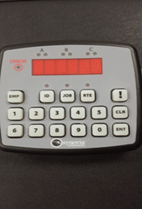
SYNOVIA TIME KEEPING SYSTEM
Press the employee button
Enter your six digit code
Press enter
Enter your job code
Press enter
Enter the route (bus) number
Press enter

Slide 35
SYNOVIA TIME KEEPING SYSTEM
If a driver or monitor forgets to clock in or out, times will be entered manually into the system using the ignition on/off times.
Always look for green light at the top left of the keypad when clocking in after your final entry. Clocking out…..make sure the green light is out after the final entry.
Driver and Monitors are responsible for submitting the required School Bus Driver Leave Request Form to their supervisor when requesting annual leave, sick leave, or bonus days.
You are allowed up to 10 minutes for Pre and Post-Trip inspections. This time is NOT automatically calculated.
Monitors are not paid for the Pre and Post-Trip inspection time.
If you are driving your regular bus and it happens to have a mechanical issue and you must drive another bus, clock out and clock in on the bus you are to drive.
Recertification/Behind the wheel-drivers will be paid 1 hour for time spent to recertify. The finance office is notified of the recertification and the time is then added by the finance staff. You will not clock in for recertification.

Slide 36
INCENTIVE PAY
In order to receive incentive pay you must complete the following:
Reports will be accurately completed and submitted on time. These include the fall Headcount, and Stop Arm Violations.
Proper use of the Inspection Flag.
Follow the TIMS route as assigned by the TIMS Department.
Any safety issues/concerns associated with routing and bus stops are called in to Angela Cox immediately.
Route updates, including student ridership, are due on the last day of every month.
Maintain a clean bus at all times.
Accidents and Cell phone violations will result in a loss of Incentive Pay for that pay period. Accidents include hitting mailboxes.
Having perfect attendance!
Bus cell phone turned on daily and bus folder up to date.
Incentive pay is $1.00 per route per day.
$1.00 AM
$1.00 PM
$2.00 Per Day

Slide 37
Getting the Students Attention
The crossing signal is the key to getting the students attention.
Students that are wearing earbuds/headphones, talking or texting on their phone, does not have the driver’s attention.
#BRAKE4BUSES

Slide 38
GETTING THE STUDENTS ATTENTION
We must take every step to protect the students we transport.
We cannot control the other motorists but we can do everything we can to make them aware of the dangers of passing a stopped school bus.
We must emphasize day after day at each bus stop that the student must look both ways exiting the bus, then continually when crossing the road and that they look at the driver to get the signal to cross.
WE NEED THEIR ATTENTION TO MAKE SURE THEY PAY ATTENTION!

Slide 39
VIDEO
Be...
Safe
Kind
Responsible

Slide 40
Bus Behavior Expectations
Consequences for Violation Related to Transportation for all students, include but are not limited to:
1st Offense - Parent notification required
Conference with driver, student, and principal
2nd Offense - Parent notification required
Conference with driver, student, and principal
One day suspension from bus
3rd Offense - Parent notification required
Conference with driver, student, and principal
Three day suspension from bus
4th Offense - Parent notification required
Conference with driver, student, and principal
Five day suspension from bus
Fifth offense - automatic 10 day suspension from school bus
Sixth offense-automatic suspension from school bus for 9 weeks

Slide 41
Driver Education Program Specialist

Slide 42
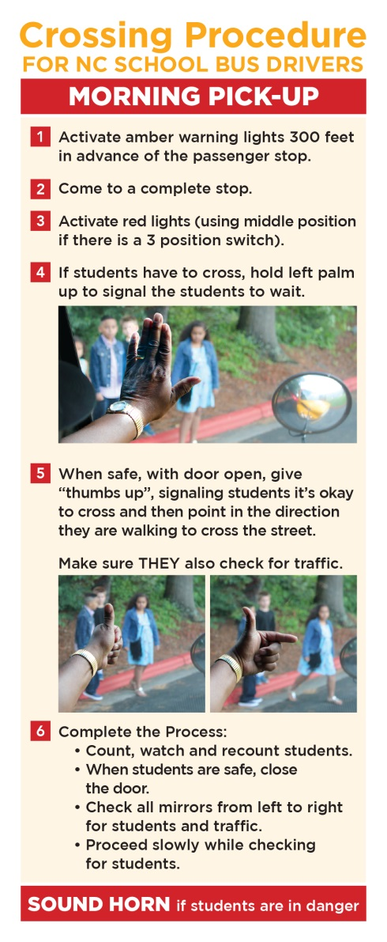
DRIVER’S MORNING INSTRUCTIONS
VIDEO
Activate amber warning lights 300 feet in advance of the passenger stop.
Come to a complete stop.
If students have to cross, hold left palm up to signal the students to wait.
Activate red lights (using middle position if there is a 3 position switch).
When safe, open door, give “thumbs up”, signaling students it’s okay to cross and then point in the direction they are walking to cross the street. Make sure they also check for traffic.
Count, watch and recount students.
When students are safe, close the door.
Check all mirrors from left to right for students and traffic.
Proceed slowly while checking for students.
IF IT IS DARK, TURN ON INTERIOR LIGHT SO STUDENTS CAN SEE YOUR SIGNAL.

Slide 43
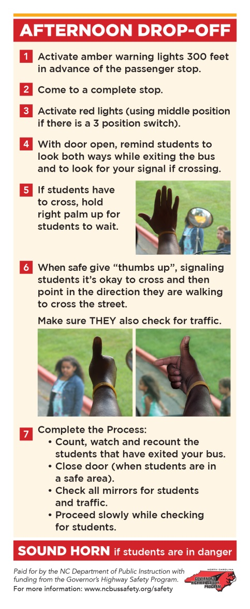
DRIVER’S AFTERNOON INSTRUCTIONS
Activate amber warning lights 300 feet in advance of the passenger stop.
Come to a complete stop .
Activate red lights (using middle position if there is a position switch).
With door open, remind students to look both ways while exiting the bus and to look for your signal if crossing.
If students have to cross, hold right palm up for students to wait.
When safe give a “thumbs up” which signals the students it's okay to cross and then point in the direction they are walking to cross the street. Make sure THEY also check for traffic.
Complete the process.
Count, watch, and recount the students that have exited your bus.
Close door (when students are in a safe area).
Check all mirrors for students and traffic.
Proceed slowly while checking for students.
If it is dark, turn on interior lights so that students can see your hands.
SOUND HORN if students are in danger!

Slide 44
Count and Recount
Counting and recounting the students as they get on and off of the bus could save the life of a child.
Count the number of students at the stop.
Count the number of students entering the bus.
If the numbers do not match, secure the bus and look for the child. Look under and around the bus for any students.

Slide 45
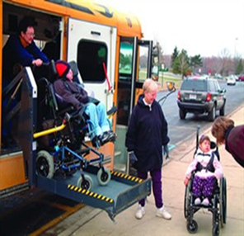
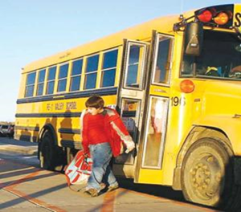
Loading and Unloading Students
You should never pass a bus that is loading or unloading. This includes at bus stops and at the schools!
Be sure that students are at least 15 to 20 feet away from the bus before closing the door! Check all 6 mirrors to make sure that a student has not come back to the bus!

Slide 46
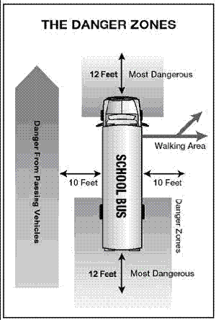
Loading and Unloading
When stopping, you should make a full stop at least 10 feet away from students.
This keeps children where you can see them.
Place transmission in park or neutral and set the parking brake at each stop.
Activate red lights when traffic is at a safe distance.
Ensure stop arm is extended.
Finally, make a last check to see that traffic has stopped before opening the door and signaling students to approach.

Slide 47
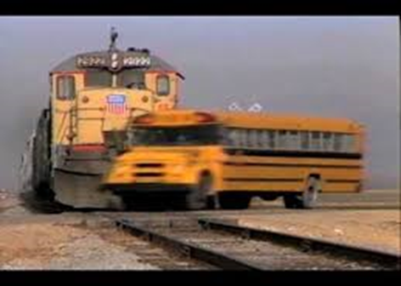
RAILROAD CROSSINGS
VIDEO
Charlotte-Mecklenburg

Slide 48
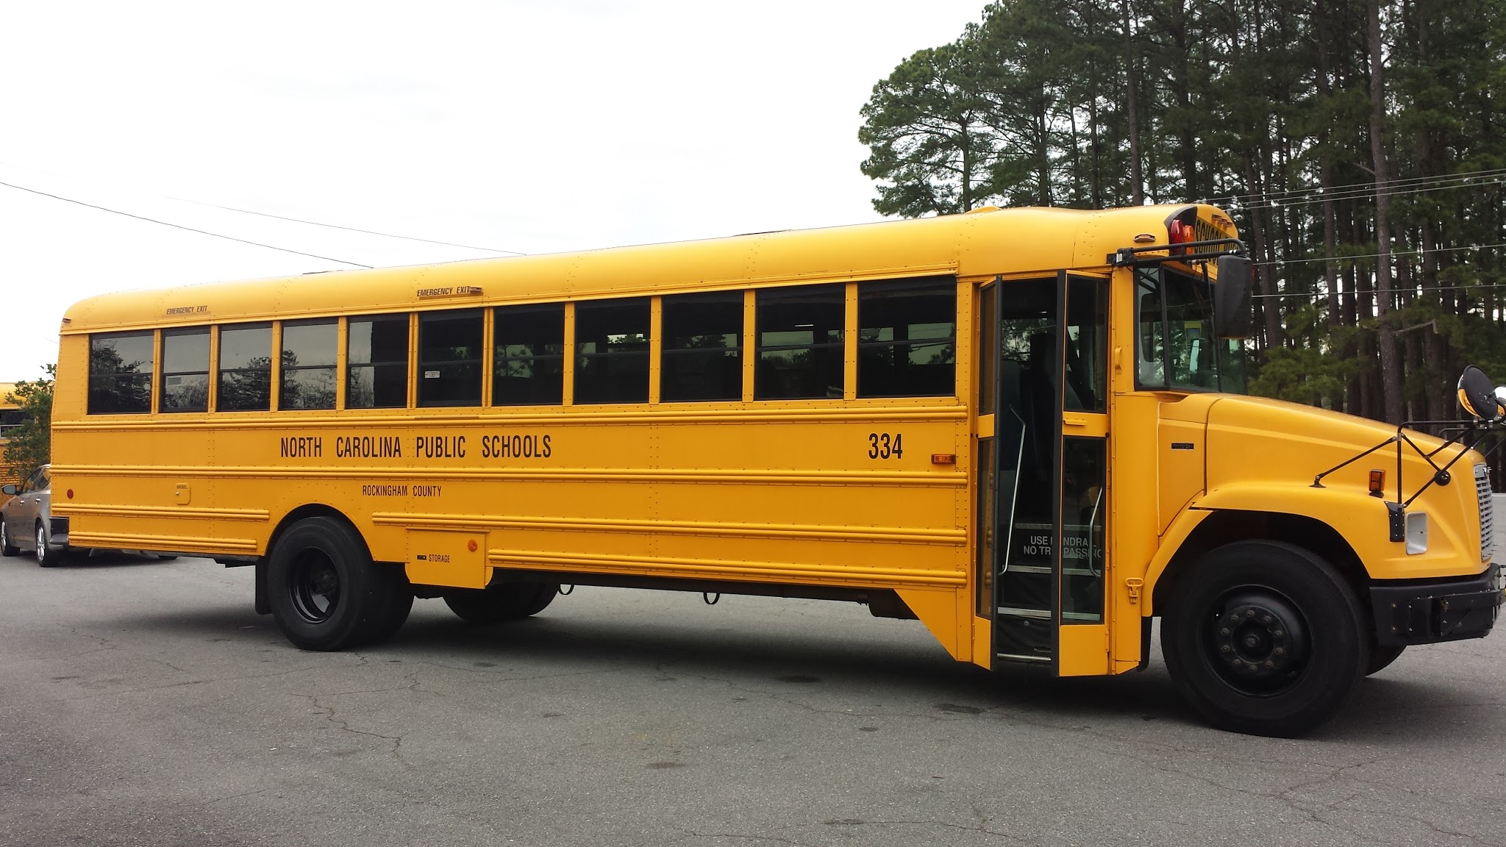
BRAKE TEST
PARKING BRAKE
AIR BRAKE (LAB)
SERVICE BRAKE

Slide 49
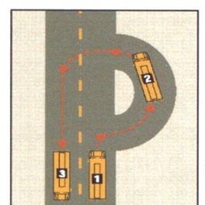
TURNAROUND
Forward Turnaround
Avoid backing when possible.
Use a safe area away from the road.
Parking lot

Slide 50
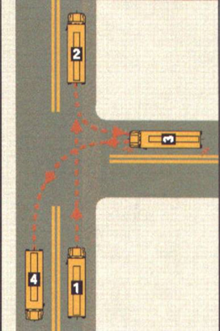
TURNAROUND
Turnaround
Right side of the road
Second Safest
Driver’s right side
Drive far enough past the side road to see it behind and to the right of the bus
Activate hazard lights
Sound horn
Use a monitor
Turn left into the correct lane of travel

Slide 51
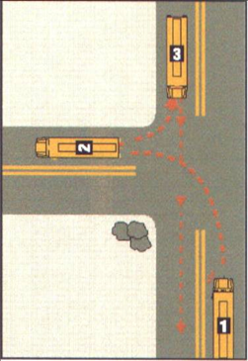
TURNAROUND
Left side of the road
Only when you have no other option
Activate Hazard Lights
Sound horn
Use a monitor
Back onto the main road (dangerous)
Turn around in designated areas only
(see Angela Cox)
Always keep the bus in the proper lane of travel
Observe all of the precautions for backing
Load passengers first before backing
Back first, then unload
Inform Angela Cox of any problems you have concerning a turnaround

Slide 52
ACTIVITY BUSES
As the driver of an activity bus, you have the responsibility of filling out the inspection sheet completely. By signing the form you are stating that all remarks are true to the best of your knowledge.
Mileage starts at the bus pick up location and ends when the bus is parked at the school to which it is assigned.
Always return the bus at the time entered on the request form. Many times Activity Buses are scheduled to go out again that same day on another trip.
Never leave the parking lot when you pick up a bus without checking the fuel level. Fuel trucks can only come to the school where the bus is assigned.
Always complete a pre and post-trip inspection.
The trip sheet must be shown to the school staff at the bus pick up location. You must also present your license before you will be given the keys to the bus.
All forms and information about activity buses can be found on the Transportation Department website.
http://www.rock.k12.nc.us/transportation

Slide 53
CHARACTERISTICS OF A BUS DRIVER
Patience…..don’t be quick to anger, be easily frustrated or have frequent outbursts.
Quick to respond…..stay calm…..have the ability to adapt to changes while on the road whether it be traffic, or students.
Route skills……know your route.
Promptness…..be a timely driver, one that is consistently on time for student pickups and drop offs.
Driving skills…..stay on route. Use good judgement!
The most important trait of any bus driver is an eye for safety. At the end of the day, the ultimate goal for every school bus driver is to keep our children safe. In order to keep our students safe, follow the rules of the road!
You are the ones that can make a difference in a child’s life! We are the support system that keeps you rolling!
Thank you for all that you do! Have a safe school year!

