Slide 1
Rockingham County Schools
Bus Monitor Training

Slide 2
Overview
Emergency Evacuations
Wheelchair lift
Wheelchair Securements
Wheelchair Integrity: A Student Safety Issue
Child Safety Restraint Systems
Star seat
E Z-on vest
Body Mechanics
Body Lifts

Slide 3
Emergency Evacuation
Rockingham County Schools

Slide 4
Reasons for Emergency Evacuation
Fire or danger of fire:
being near fire and unable
to move the bus.
Or being near presence
of gasoline or other
combustible material
The bus should be stopped and evacuated immediately if the engine or any portion of the bus is on fire.
Students should be moved to a safe place 100 feet or more from the bus and instructed to remain there until the driver has determined that the danger has passed.
RCS Children with Special Needs and the School Bus handbook p 9-10

Slide 5
Reasons for Emergency Evacuation
Unsafe position when the bus is stopped because of
an accident
mechanical failure
road conditions
human failure
the driver must determine immediately whether it is safer for students to remain in or to evacuate the bus.
RCS Children with Special Needs and the School Bus handbook page 9-10

Slide 6
Mandatory Evacuations
The driver must evacuate the bus when the following situations arise:
Fire or threat of fire is apparent.
The final stopping point is in the path of a train or is adjacent to railroad tracks.
RCS Children with Special Needs and the School Bus handbook page 9-10

Slide 7
Mandatory Evacuations
The stopped position of the bus may change and increase the danger
A bus comes to rest near a body of water or at a precipice where it could still move and go into the water or over a cliff. The driver should be certain that the evacuation is carried out in a manner which affords maximum safety for the students.
The stopped position of the bus is
such that there is danger of collision
RCS Children with Special Needs and the School Bus handbook page 9-10

Slide 8
Mandatory Evacuations
Sight distance
In normal traffic conditions, the bus should be visible for a distance of 300 feet or more.
A position over a hill or around a curve where such visibility does not exist should be considered reason for evacuation.
RCS Children with Special Needs and the School Bus handbook page 9-10

Slide 9
Emergency Exits Video
https://www.youtube.com/watch?v=nozR3mAo1r0

Slide 10
Where are the EXITS? Video added
Rear emergency door exit
Front door (service door) exit.
Students in the front half exit through the front door and students in the rear half exit through the rear door
Responsible individuals should be familiar with the operation of emergency windows and roof hatches. During drills they should be given the opportunity to open these exits to ensure their ability to operate these devices

Slide 11
Order of Evacuation Considerations
Order in which to Evacuate Students from the Bus
Typically students who are able to walk are evacuated first
unless behavior problems would create additional hazards.
The next students to be evacuated are those who are nearest to the source of danger,
followed by those next closest, etc.
A Guide for the Transportation of Preschoolers and Children with Disabilities for North Carolina Public Schools - June 2008 page 8-7

Slide 12
Order of Evacuation Considerations
The students ability:
which students can help other get off the school bus?
Which students can come off the school bus by themselves?
Which students will need close supervision?
Which students might be paired with another for safety?
Which emergencies will require you to remove the student from their wheelchair?
Which emergencies will allow you to remove the student AND their equipment?
Deciding order/sequence of evacuation emphasis: GET THE MOST STUDENTS OUT IN THE SHORTEST TIME !!!
Compartmentalization may prohibit the visibility of, as well as the ability to hear students.

Slide 13
Exiting Bus in Emergency
DO NOT jump out of lift or emergency doors.
Sit on the floor of the bus then safely exit emergency door.
From outside bus, assist student to sit on bus floor before exiting safely to ground.

Slide 14
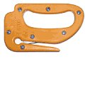
What equipment do you need for an evacuation?
Belt cutter (TWO belt cutters should be located on each bus!)
The belt cutter has a razor-sharp cutting edge safely built in to a plastic handle. It looks similar to a letter opener.
It can cut seat belts and tie-down straps (CUT THE MOUNT NOT THE VEST ON STAR SEATS)
The belt is fit into the slot and the blade cuts with one motion
Store the belt cutter in a location that is easily accessible to the bus driver and monitor but that the students can’t reach
Blanket
Some buses may be equipped with a blanket
for the emergency evacuation of fragile or heavy
students

Slide 15
Individual Evacuation Plan MUST be documented in the NOTEBOOK. Check during pre-trip.

Slide 16
Federal Highway Standards 17 requires that school bus emergency evacuation drills be conducted within the first 5 days of school and at least twice each year. Students transported in a school vehicle should be instructed in safe riding practices and participate in emergency evacuation drills.
This form serves as documentation of such action and is to be signed by the bus driver, monitor and school designee responsible for the employees of the bus. Check off each required procedure that driver has reviewed with monitor and then sign.
___ 2 Belt Cutters – Locate and check – in reach of driver - monitor
Emergency Exits (front door, rear door, windows and roof hatches) – point out
Evacuation Blanket (If bus has one) – locate
____ First Aid Kit – locate and check for all contents (4”bandage compresses (2 packages), 2” bandage compresses (2 packages), 1” bandage compresses (16 per package), 40 “ triangle bandage with 2 safety pins (2 packages), Non-latex gloves (2 pair, medium and large)
____ Lift Operation – Manual and Power operating processes reviewed and practiced
Date: ___________________
Bus: ___________________
School Designee: _____________________________________________
Bus Driver: __________________________________________________
Monitor: ____________________________________________________

Slide 17
Additional Information Evacuation
“A Guide for the Transportation of Preschoolers and Children with Disabilities for North Carolina Public Schools”
Transportation Policies, Guidelines, and Best Practices
Chapter 8 pages 8-1 through 8-17
www.ncbussafety.org/EC/Manual/EC_Transp_Manual2008.pdf

Slide 18
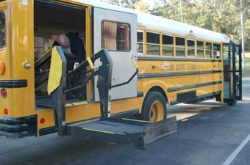
WHEELCHAIR LIFTS
GENERAL GUIDELINES
And Procedures

Slide 19
GUIDELINES
ALL WHEELCHAIRS MUST FACE FORWARD
NEVER CARRY A CHILD ON OR OFF THE BUS, FOLLOW THE INDIVIDUAL TRANSPORTATION PLAN IN THE NOTEBOOK
STORE ALL CRUTCHES OR LAP TRAYS SECURELY IN DESIGNATED AREAS
NEVER RIDE THE LIFT WITH THE STUDENT

Slide 20
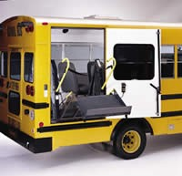
Lift Door
Check visually to make sure the pathway of the door is clear before opening swing door.
Open and Secure the lift door.

Slide 21
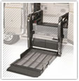
Loading: Operating the Lift with Power
Use the hand-held control to activate the unfolding of the ramp
Using the unfold and down buttons Lower the ramp until it rests entirely on the ground
Unfold the outboard roll stop
outboard roll stop

Slide 22
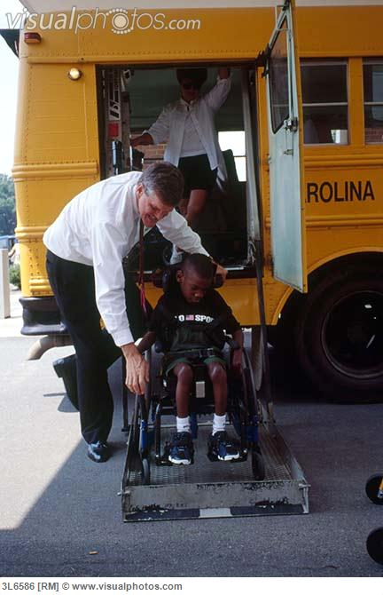
Loading
Have caregiver back the student onto the ramp
Always face the student away from the school bus
Question care giver to make sure student’s
Seatbelt is fastened
Brakes are engaged
Instruct Caregiver to hold to the frame of the wheelchair while the lift is in process.
Use hand control Up button to raise lift to bus floor level
Adult inside the bus should grasp the push handle as soon as he/she can safely reach it.

Slide 23
Loading
AFTER student is secured for transportation the ramp is folded up.
Using the hand control: fold up the ramp
Make sure path is clear: Close and lock lift door

Slide 24
Loading
Apply wheelchair securements for student safety BEFORE folding ramp in and before closing the door.
The goal is to get the child secured for safety THEN return attention to the lift.

Slide 25
Unloading: Operating the Lift with Power
When the bus comes to a stop and BEFORE Removing student/wheelchair securements
Open lift door and set door lock
Using hand control to unfold ramp

Slide 26
Unloading
Roll student onto the ramp. LOCK BRAKES!
Instruct caregiver to hold to frame of wheelchair for the descent.
Using hand control lower ramp to ground
Caregiver will roll student from ramp.
When area is clear, using hand controls
Raise ramp and fold in
Close and lock door.

Slide 27
Manual lift: VIDEO LINK
Manual Lift will be demonstrated and practiced during the training session.
https://www.bing.com/videos/search?q=operating+wheelchair+lift+on+school+bus&&view=detail&mid=4009D65BCA64381BFBC34009D65BCA64381BFBC3&&FORM=VRDGAR

Slide 28
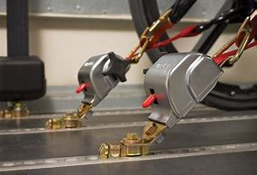
Wheelchair Securements

Slide 29
Wheelchair Securement Systems
Refers to the devices used to secure a wheelchair to the school bus.
Securements Include
buckles, hooks
floor anchors
webbing/straps.

Slide 30
ATTACHING THE FRONT TIE DOWN STRAPS
Attach the floor track fittings of front tie down straps 3” to 8” outside the front wheels of the wheelchair. •
Both front tie down straps must have the same type of buckle.-
Hook the tie down strap to the securement sites on the front of the wheelchair frame at 30-60 degree angle as pictured.

Slide 31
ATTACHING THE REAR TIE DOWN STRAPS
Attach the floor track fittings of rear tie down straps just inside the large, back wheels of the wheelchair.
Both rear tie down straps must have the same type of buckle.
Hook the tie down strap to the securement sites on the rear of the wheelchair frame at 30-45 degree angle as pictured.

Slide 32
Lap Belt
Position the lap belt:
Over the pelvic bones, not the abdomen.
Inside the arm rests between the side panels and the cushion.
Adjust the lap belt so it is snug.
Position the shoulder belt so it does not cross the students face or neck. Never position the shoulder belt under the students arm where it would cross the rib cage.
Adjust the shoulder belt to achieve firm but comfortable tension.
Never twist the belts. The belts should always lie flat against the body.

Slide 33
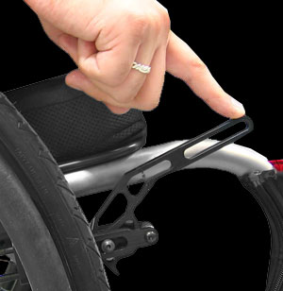
Checking for Proper Securement Shake test
After Wheelchair is secured and lapbelt applied Release wheelchair brakes and give the chair a shake.
If the chair can be moved forward or backwards the securements should be tightened again.
Once the chair passes the shake test…
REAPPLY WHEELCHAIR BRAKES.

Slide 34
Sure lock Wheelchair Securement video
https://vimeo.com/109514159

Slide 35
Things to Remember

Slide 36
Positioning Wheelchair on Bus
Position the wheelchair forward facing.
Manual Wheelchair: secure the wheel locks.
Power wheelchair - re-engage gears on motors to activate internal locking mechanism. Make sure
power is off.

Slide 37
Wheelchair Securements
Attach the S hook directly to the FRAME of the wheelchair as shown. 2 in front/2 in the back.
They are not attached to the wheels or any detachable portion of the wheelchair.
Do not twist straps

Slide 38
Wheelchair: Tilt and Recline
Students should be transported in a position as close to upright as possible.
It is recommended that if tilted/reclined, the angle of tilt/recline should be no greater than 30 degrees.
A Guide for the Transportation of Preschoolers and Children with Disabilities for North Carolina Public Schools - June 2008 page 7-18

Slide 39
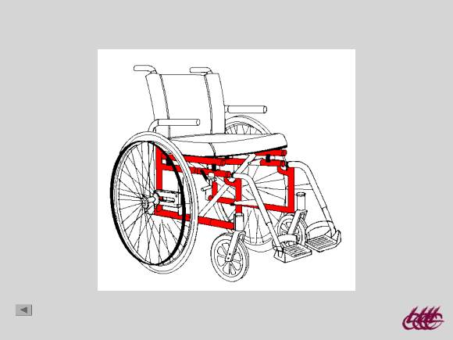
TIEDOWN TO THE FRAME
THE FRAME IS THE SOLID COLORED PART OF THE WHEELCHAIR

Slide 40
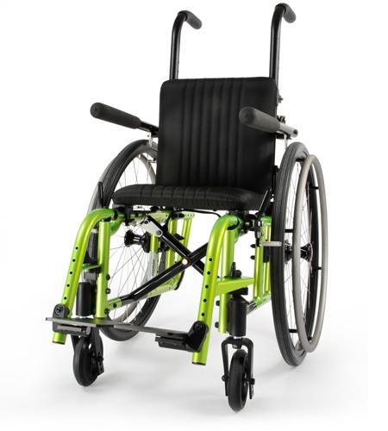
NEVER TIE DOWN to the WHEELCHAIR CROSSBAR!!
DO NOT TIE DOWN TO THE LEG RESTS OR WHEELS

Slide 41
Loading: Order of Securement
1. Apply front securements
2. Apply and tighten Rear securements
3. Apply lap belt after wheelchair is secured.

Slide 42
Unloading: order of removing securements
Front securements
Lapbelt
Rear securements

Slide 43
Power Wheelchairs
NOTE: To load/unload a student with a motorized wheelchair
Special Needs Transportation Handbook provided by the EC department describes safety procedures, review your options.
The tie down procedures for power chairs are the same as manual chairs; do not tie down on any part that is removable. Be sure you are tying down to the frame of the chair.
The power wheelchairs should not be driven on – off the bus in the raised position.
Contact transportation dept if you have a power chair on your route

Slide 44
DO NOT RELAY MESSAGES FROM PARENT/CAREGIVER TO TEACHER OR VICE VERSA.
ASK THE PARENT OR CAREGIVER TO CALL THE INVOLVED PERSON

Slide 45
Wheelchair Integrity
A Student Safety Issue

Slide 46
Wheelchair Integrity
Wheelchairs should meet certain criteria to be determined safe for transport.
If tires are loose or not functioning properly
‑ the chair will be difficult to move or may move unpredictably
If tires are deflated or have insufficient tread
wheel locks will not secure the wheelchair
If wheel locks do not work properly
- chair may roll on power lift or in bus
Page 7 - 18 A Guide for the Transportation of Preschoolers and Children with Disabilities for North Carolina Public Schools - June 2008

Slide 47
Wheelchair Integrity
If the wheelchair seat belt is broken or missing
- student risks falling out of the wheelchair on the lift or inside the bus.
If Wheelchair insert (back support mechanism on certain chairs) is loose/unattached to the wheelchair
- student not fully restrained and may lunge forward at a sudden stop
If a power wheelchair is malfunctioning in any way
- could move unpredictably and cause harm to occupant or others
If Extra equipment, such as a respirator or oxygen tank, is not secured properly
- may not function correctly or may fall off wheelchair (pressurized tanks could explode
A Guide for the Transportation of Preschoolers and Children with Disabilities for North Carolina Public Schools - June 2008 page 7-18

Slide 48
Wheelchair Integrity
If a student arrives to be transported to school in a broken wheelchair
THIS IS A SAFETY ISSUE
Do not transport a student in a broken wheelchair
Do not place a student in a broken wheelchair on the lift.
So what should one do when a student arrives to be transported to school in a broken wheelchair???

Slide 49
REMAIN CALM ☺
Alert caregiver to your concerns for child safety.
Briefly explain NC guidelines for wheelchair integrity and safety on school bus.
Contact Bus garage ASAP if a wheelchair needs repairs!!!
A member of the PT department will be available ASAP to help resolve the issue.
Wheelchairs must be functioning properly in order to keep students safe during school and transportation.
REMEMBER!
Wheelchairs must be functioning properly in order to keep students safe during school and transportation.

Slide 50
WHEELCHAIR MODIFICATION/ADJUSTMENTS
DO NOT ADJUST WHEELCHAIR POSTURAL SUPPORTS AT THE FRAME OF THE WHEELCHAIR FOR ANY REASON (seatbelt or chest harness)
Do not use tools to fix or adjust wheelchair.
NOTIFY YOUR CONTACT AT THE BUS GARAGE IF THERE ARE CONCERNS. They will contact the Physical Therapy department who will work to resolve wheelchair concerns ASAP.

Slide 51
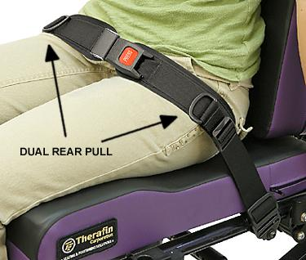
Tightening Seatbelt
If the seatbelt loosens please pull straps or D rings (depending on style of belt) to tighten.
The belt should fit snugly against student’s body
If the seatbelt comes loose from the frame please contact the bus garage.
Tighten at buckle

Slide 52
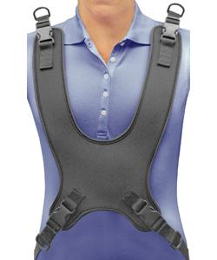
Tightening Chest Harness
FIRST: adjust-Pull the bottom straps/D rings first
This keeps the harness from being drawn up toward the airway/neck which could restrict the student’s respiration.
THEN tighten the straps at the top if needed.
The harness should fit against students body with enough room for your open hand to slide comfortably between harness and student’s body.

Slide 53
Child Safety Restrain Systems
Star Seats
E Z on Vest

Slide 54
Star Seats
The STAR seat is a 5-point, add-on restraint system that easily adjusts to provide a proper, secure fit for children
https://www.youtube.com/watch?v=GZHfJJHEp-M
Start video at 2:44

Slide 55
Star Seat Evacuation
Cut both straps below harness clip
Unthread or remove the harness clip from the belt
Help the student out of the seat

Slide 56
Securing student on bus EZ on vest
START VIDEO AT 1:28
https://www.ezonpro.com/our-products/vehicle-mounts/seat-mount-seat-mount-high-back/#videoinstruction

Slide 57
EZ on Max II Vest
Start video: 1:16
https://www.youtube.com/watch?v=ryvU6Xek_XI

Slide 58
Child Safety Restraint Systems
Students using star seats and EZ On vest should
be positioned on seats toward the front of the bus to provide drivers with quick access to and a clear view of the student.
They should not be positioned on seats adjacent to emergency exits.
If an unrestrained student shares the seat with a student using an Safety Restraint System, the student using the restraint should be placed next to the window.
The bus seat behind it must be empty or be occupied by another student who is using a child safety restraint system.
A Guide for the Transportation of Preschoolers and Children with Disabilities for North Carolina Public Schools - June 2008 page 7-10

Slide 59
Body Mechanics

Slide 60
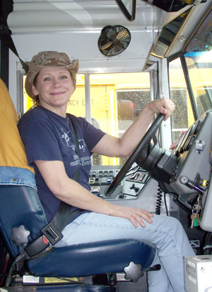
Back Safety for Drivers
Use good sitting posture!
Back straight and against your seat,
knees bent and feet flat on the floor.
Shoulders back
adjust your steering wheel.
Adjust your mirrors to see the entire bus viewing area.
Take your wallet out of your pants pockets.

Slide 61
General Lifting Guidelines
Never lift anyone more than 50 lbs without help
***per Susan Shutrump
Test your lifting ability with a small movement that can be stopped
If the student weighs too much, use another method or ask for help.

Slide 62
Lift with your legs, not with your back.
Do not bend over at your waist to pick up things.

Slide 63
Establish A Wide Base of Support
Stand balanced with your feet shoulder width apart
Face the student
Face in the direction you want to go, if possible
Get a good grip on the student or the student's clothing; use your palms, not just your fingers

Slide 64
General Lifting Guidelines continued
Process
Clear the path to the exit
Tell the student exactly what you are going to do before you do it
If necessary, cut the seat belt and other positioning straps

Slide 65
General Lifting Guidelines continued
Get as close to the student as you can
Lift gradually (without jerking) using your legs
Keep the student as close to you as possible
Keep your chin tucked in so as to keep a relatively straight back and neck line

Slide 66
Pivot with your feet Do not TWIST at the waist
Once you’re standing, change directions by pointing your feet in the direction you want to go and turning your whole body
Avoid twisting at your waist while carrying a student
Take small steps, keeping the student close to your body

Slide 67
Lift Procedures
One person lift
Two person lift
Blanket drag

Slide 68
Techniques you may need to know to get students with special needs out of the school bus in an emergency
The one-person lift
The 2-person lift
The blanket drag
For all lifts use the general lifting guidelines.
Move the student in a wheelchair as close to the exit as possible
Slide the student on a seat next to the aisle

Slide 69
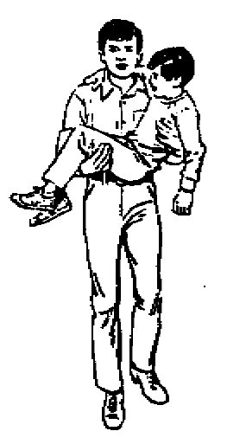
The one-person lift (for a smaller student)
Pass the student’s near arm over your shoulder
Place one of your arms behind the student’s shoulders with your hand under the student’s other arm
Place your other arm under the student’s knees
Squat down with feet shoulder width apart
Lift the student with the load equally divided between both arms, holding the student close to you

Slide 70
The Two Person Lift
The taller person stands behind the student and takes the lead role for the lift. The other person stands in front of the student and off to the side
If the student is in a wheelchair, the person in front should remove the armrests and fold up the footrests

Slide 71
Two Person Lift
The person in back reaches under the student’s arms and
Either grasps right hand to student’s right wrist and left hand to student’s left wrist
Or clasps hands across the student’s chest
The person in front lifts the lower extremities under the thighs and hips
Squat down and lift together on a count of three
Move to the designated area and lower the student on the count of three

Slide 72
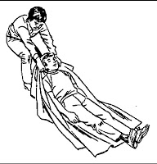
Blanket Drag
Fold a blanket in half and place in on the floor next to the student
Lower the student safely onto the blanket
Place the student with his head toward the exit
Wrap the blanket around the student to prevent arms and legs from being caught on obstacles
Grasp the blanket near the student’s head and drag the student to the exit

Slide 73
Documentation of Training Form
Name_______________________ Date _________________
Body Mechanics_______
Wheelchair tie down system______
Wheelchair lift system
Power _______
Manual _______
Emergency exiting ___________
I received the handbook
Children with Special Needs School Bus Driver_______
I received instruction in the areas listed above______

